Slide 1
Measuring Time Series
Forecasting Errors
Renato R. Maaliw III, DIT
Professor 1, College of Engineering
Southern Luzon State University
Lucban, Quezon, Philippines

Slide 2

Motivation:
Forecasting is at the heart of predictions. Accurately forecasting the future drives strategic actions, yet no forecast is perfect.

Slide 3
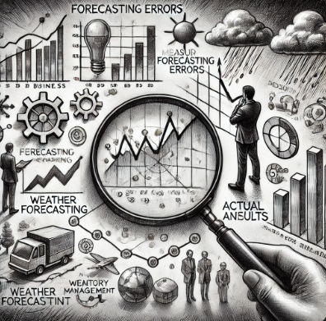
Motivation:
Understanding & measuring forecasting errors is essential, it provides a quantitative way to evaluate how close our predictions to reality.

Slide 4
Why Measure
Forecasting Errors?

Slide 5

1. Model Selection
Error metrics act as benchmarks that allow us to compare different model’s performance objectively.

Slide 6

2. Risk Management
Forecast errors are a reality, but by quantifying them, we can better assess and manage the risks involved.

Slide 7
Key Measures of
Forecasting Errors

Slide 8
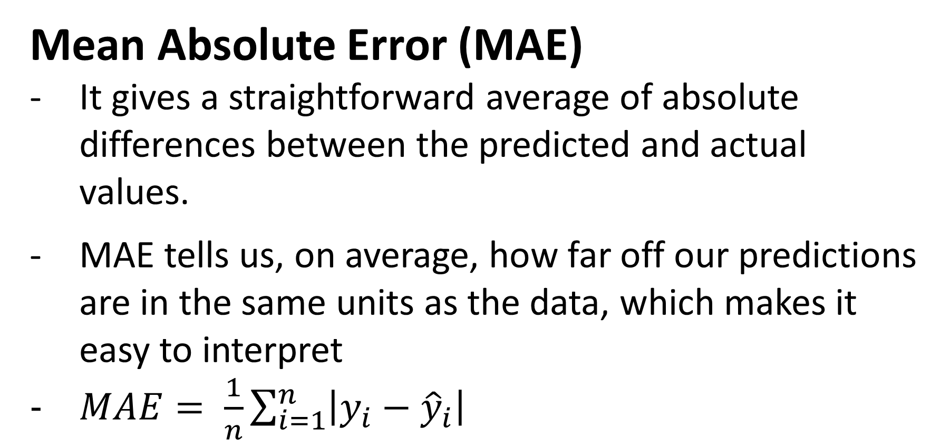
Mean Absolute Error (MAE)
It gives a straightforward average of absolute differences between the predicted and actual values.
MAE tells us, on average, how far off our predictions are in the same units as the data, which makes it easy to interpret
$MAE= \frac{1}{n}\sum_{i=1}^{n}{\left|y_{i}−{\hat{y}}_{i}\right|}$

Slide 9
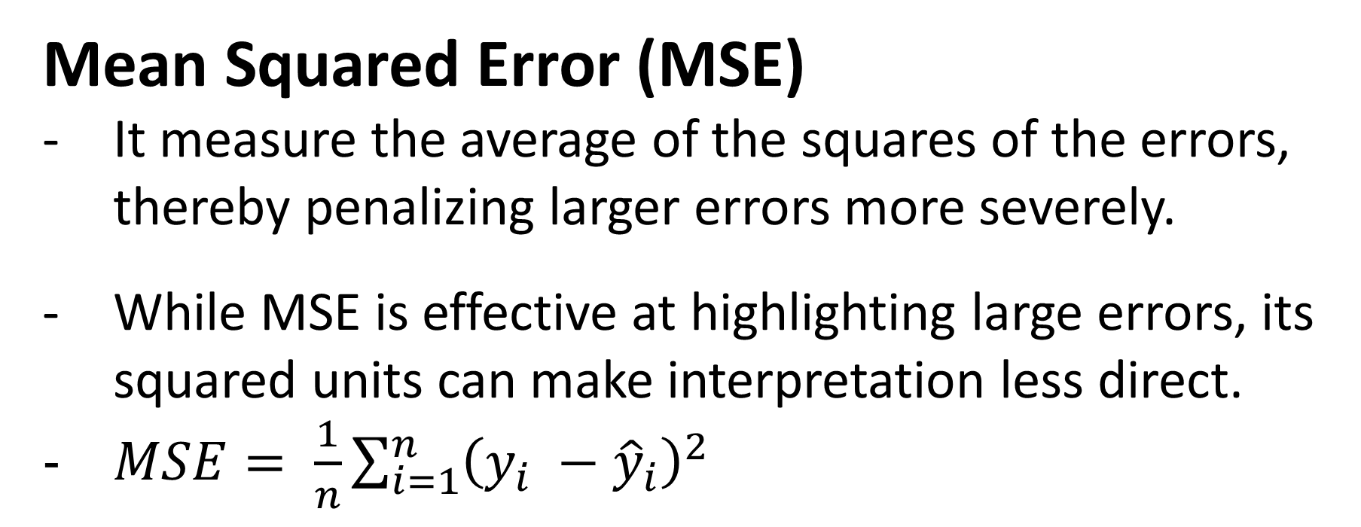
Mean Squared Error (MSE)
It measure the average of the squares of the errors, thereby penalizing larger errors more severely.
While MSE is effective at highlighting large errors, its squared units can make interpretation less direct.
$MSE= \frac{1}{n}\sum_{i=1}^{n}{{\left(y_{i} −{\hat{y}}_{i}\right)}^{2}}$

Slide 10
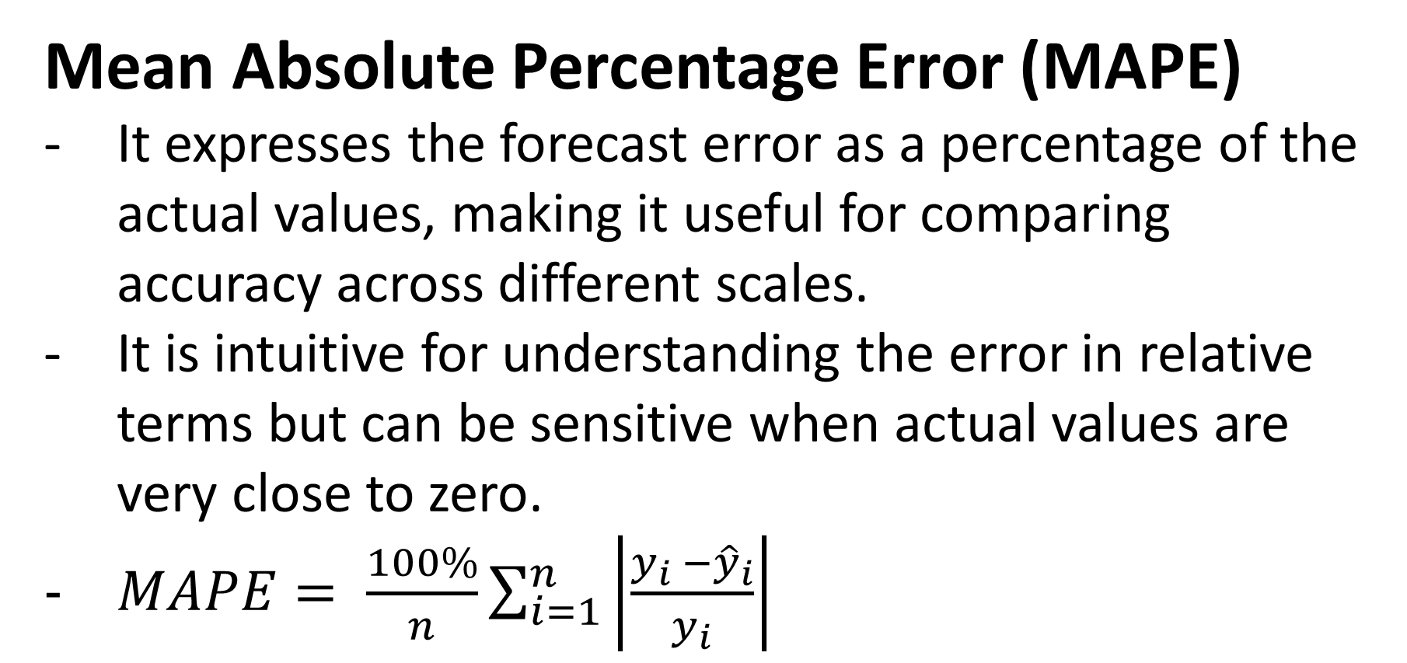
Mean Absolute Percentage Error (MAPE)
It expresses the forecast error as a percentage of the actual values, making it useful for comparing accuracy across different scales.
It is intuitive for understanding the error in relative terms but can be sensitive when actual values are very close to zero.
$MAPE= \frac{100\%}{n}\sum_{i=1}^{n}{\left|\frac{y_{i} −{\hat{y}}_{i}}{y_{i}}\right|}$

Slide 11
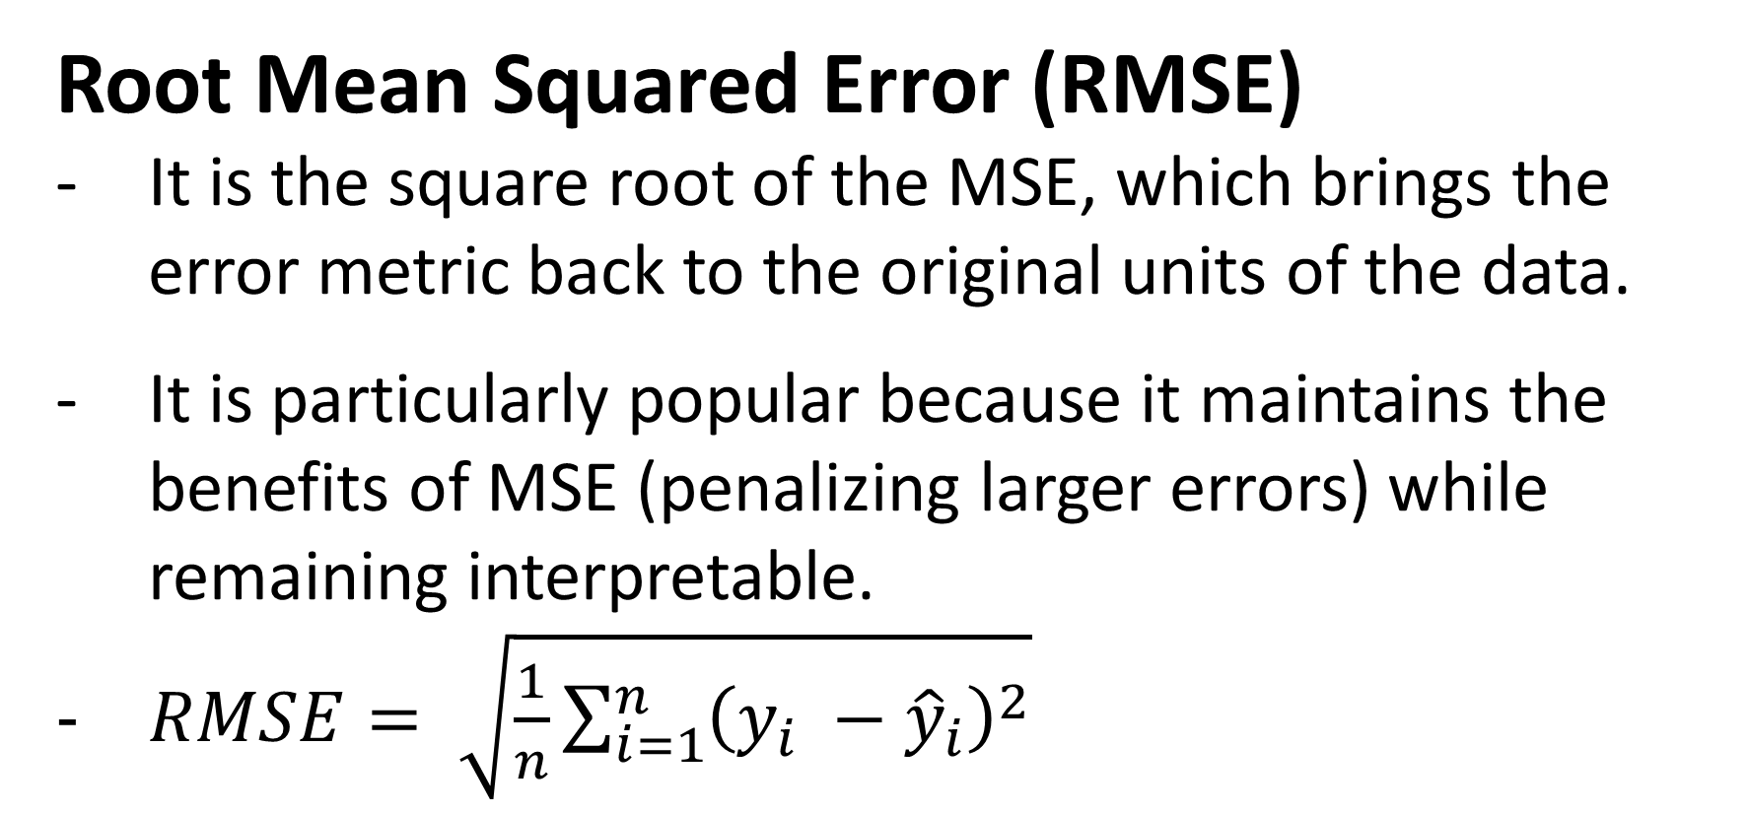
Root Mean Squared Error (RMSE)
It is the square root of the MSE, which brings the error metric back to the original units of the data.
It is particularly popular because it maintains the benefits of MSE (penalizing larger errors) while remaining interpretable.
$RMSE= \sqrt{\frac{1}{n}\sum_{i=1}^{n}{{\left(y_{i} −{\hat{y}}_{i}\right)}^{2}}}$

Slide 12
Examples

Slide 13
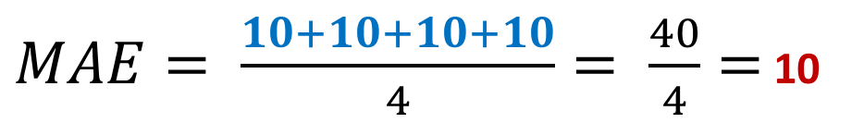
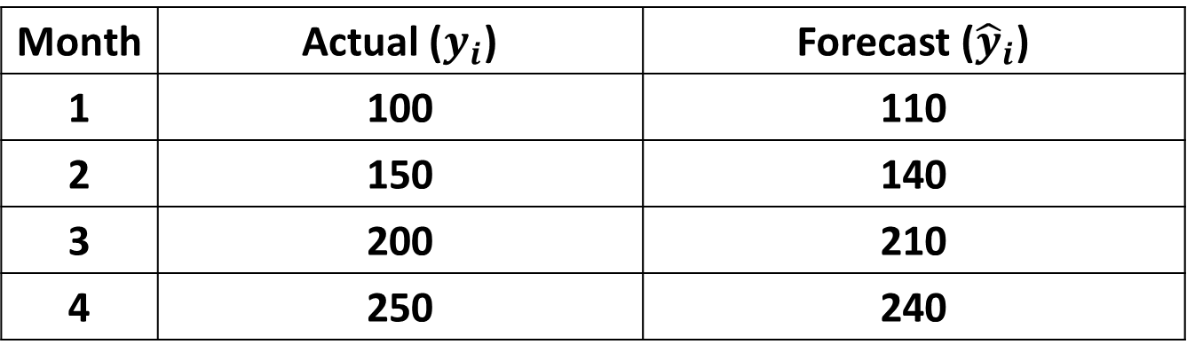
Month | Actual ($y_{i}$) | Forecast (${\hat{y}}_{i}$)
1 | 100 | 110
2 | 150 | 140
3 | 200 | 210
4 | 250 | 240
Month 1: 100 − 110 = 10 (absolute)
Month 2: 150 − 140 = 10 (absolute)
Month 3: 200 − 210 = 10 (absolute)
Month 4: 250 − 240 = 10 (absolute)
$MAE= \frac{10+10+10+10}{4}= \frac{40}{4}=$ 10
Interpretation: On average, the forecast is off by 10 units

Slide 14
[Code Demo]

Slide 15
Thank you very much for listening.

